Slide 1
Hybrid Mesh Volume LoDs for all scale prefiltering of complex 3d assets

Slide 2
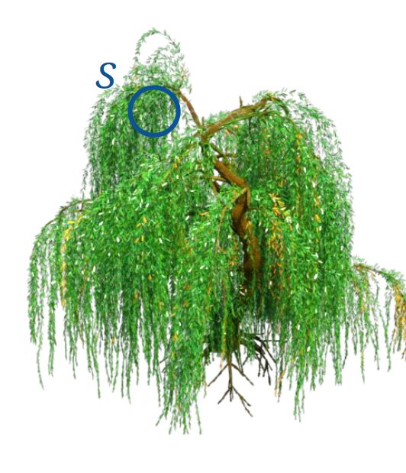

LoDs goal’s
Reduce amount
Preserve appareance
Automatic
Seamless transitions
1 tree = 1 million leaves
1 scene = millions of assets
Why ?

Slide 3
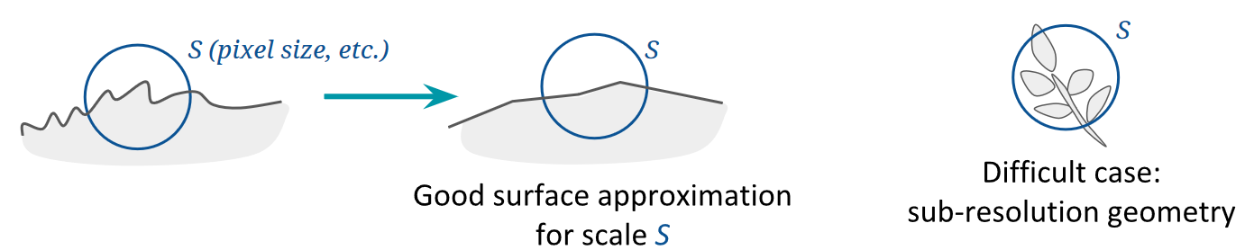
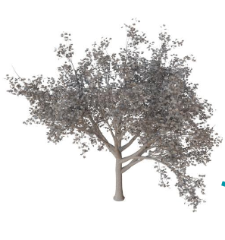
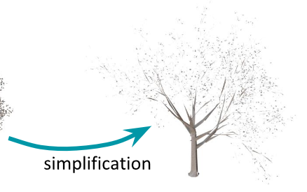
Difficulty of old Lod’s
Adaptive mesh resolution : mesh simplification / subdivision surfaces

Slide 4

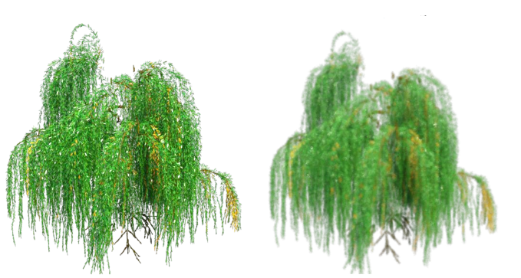
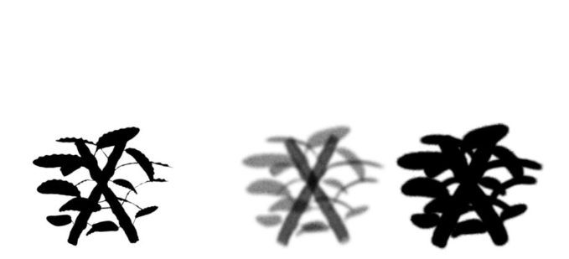
Difficulty of old Lod’s
Base on volumetric approximations

Slide 5
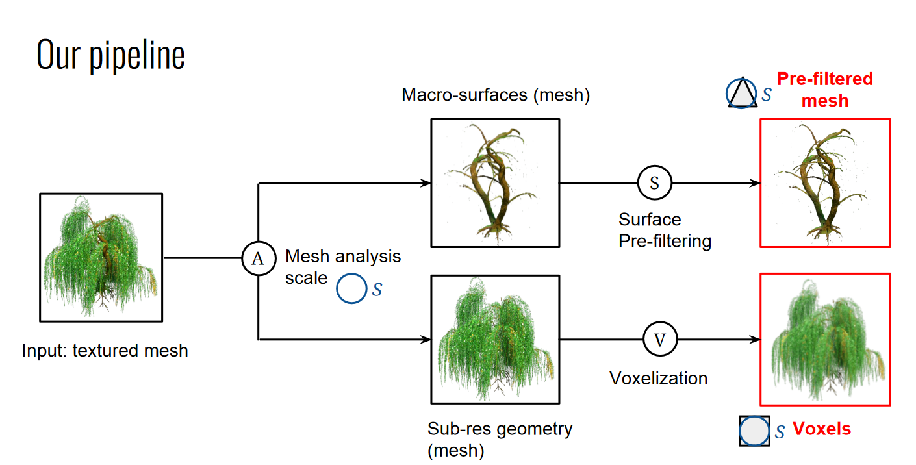
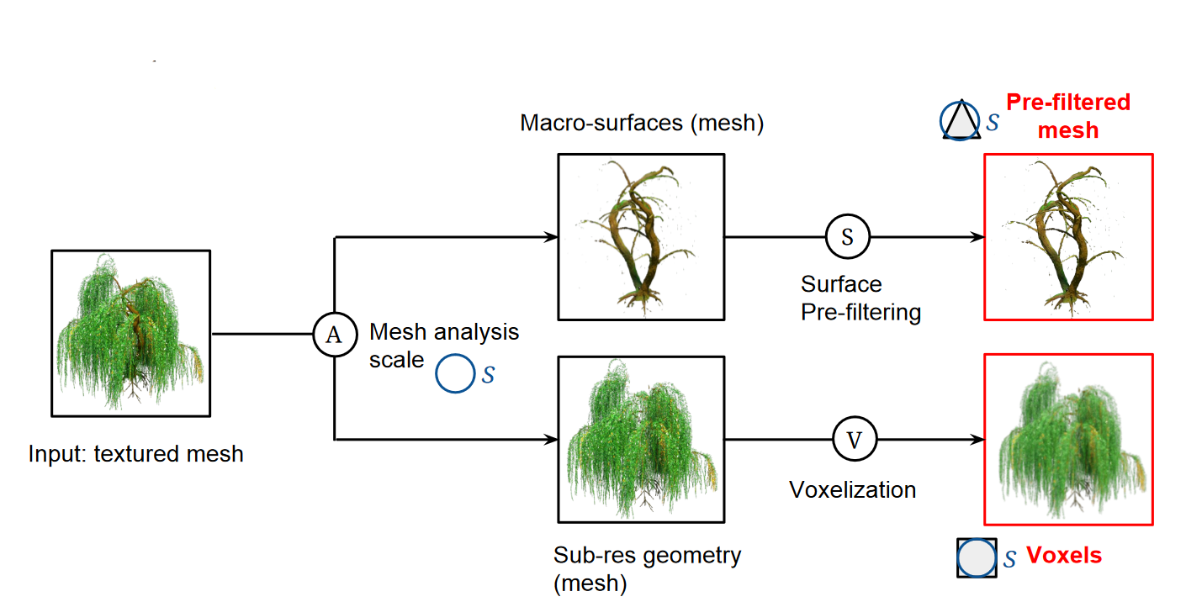
Contributions of this article

Slide 6
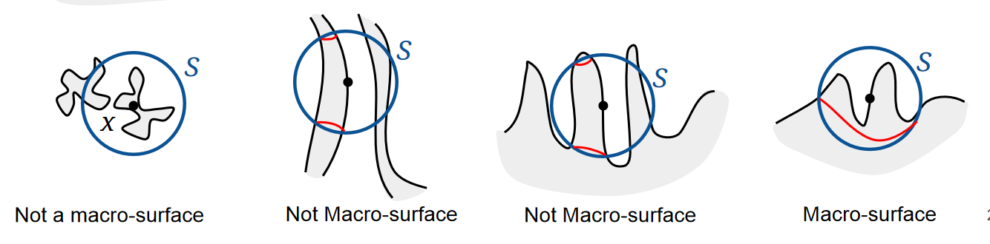
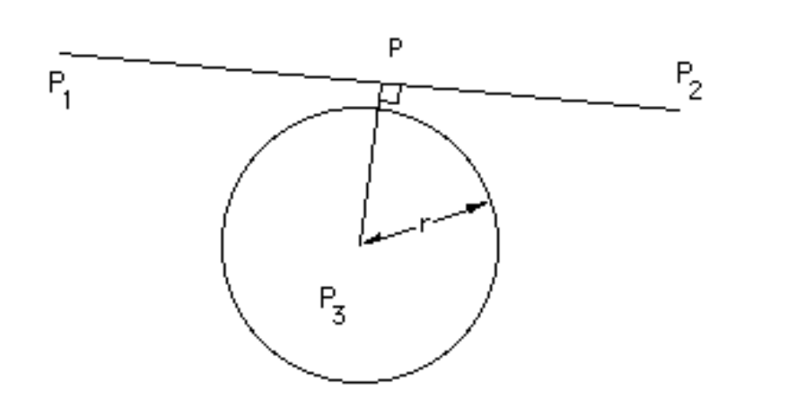
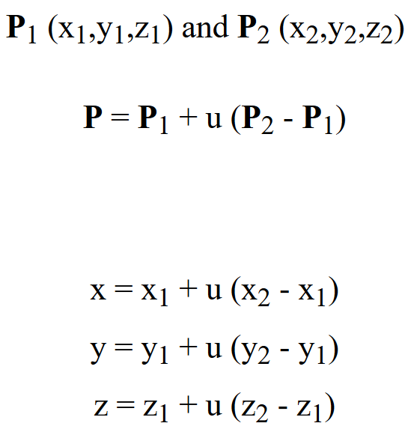
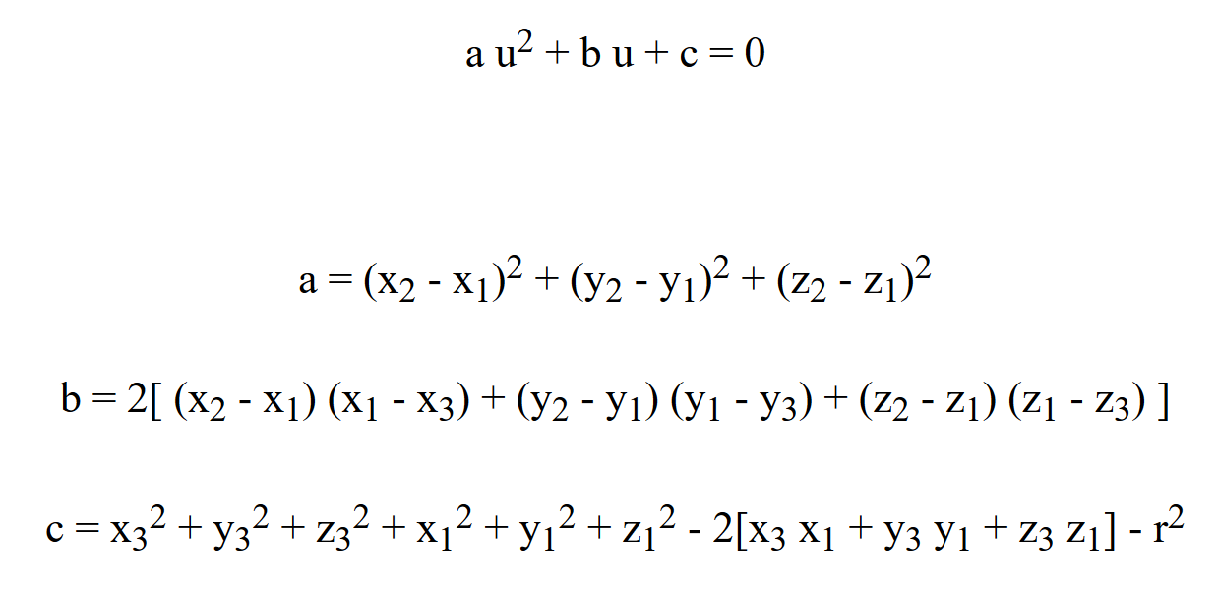
Split Macro / Sub geometry
Intersection Line/Sphere

Slide 7
Creation de la structure half edges
$$\left\{ , , \right\}$$
$$\left\{ \left(x1,x2,x3\right) , \left(y1,y2,y3\right) , (z1,z2,z3) \right\}$$
$$\left\{ \left(1,−1,−1\right) , \left(0,−1,−1\right) , (1,−1,−1) \right\}$$

Slide 8
Is On Macro Surface
While Triangles_To_Explore != empty :
current_Triangle=Triangles_To_Explore.pop();
Explore (current_Triangle);
Explored_Triangles.push(current_Triangle);
Barycentre / Radius fixé
Explore () { Pour les triangles voisins du current_Triangle :
Si Intersection Sphere && Si not in (Triangles_To_Explore and Explored_Triangles):
Triangles_To_Explore.push();
Si current_Triangle interects Sphere :
List_Triangles_Intersection+=current_Triangle }

Slide 9
Has Single Component ?
List_Triangles_Intersection -> CurrentGroupe -1,…….., -1
When it exists triangles that has not been visited :
Q.push (Ensemble_Triangles_Intersection not visited yet );
IndexCurrentGroupe++;
While Q != empty :
Pour voisins de Q s’il existe :
if not visited yet :
currentGroupe ->IndexCurrentGroupe;
Q . push ( triangle ) ;

Slide 10
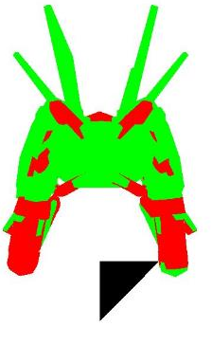
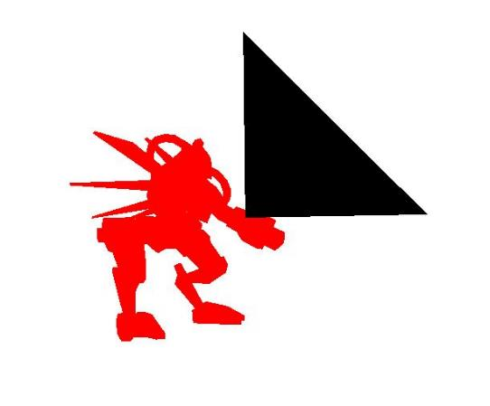
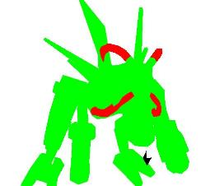
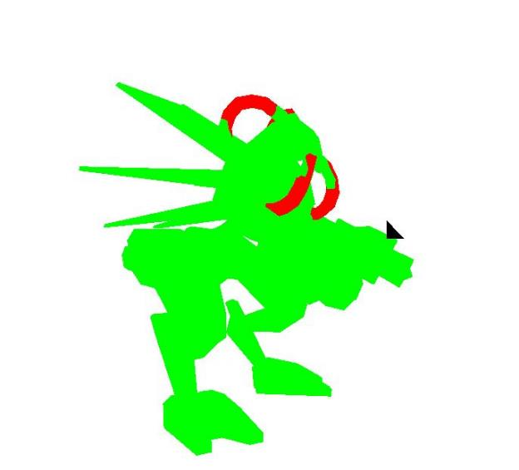
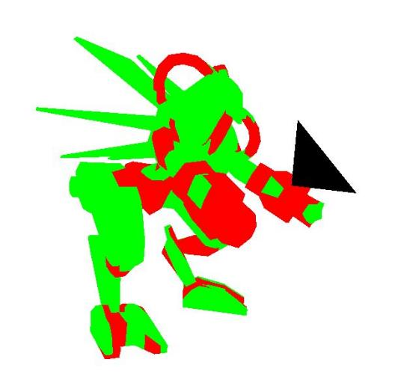
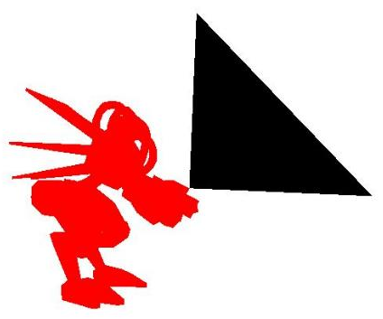

Slide 11
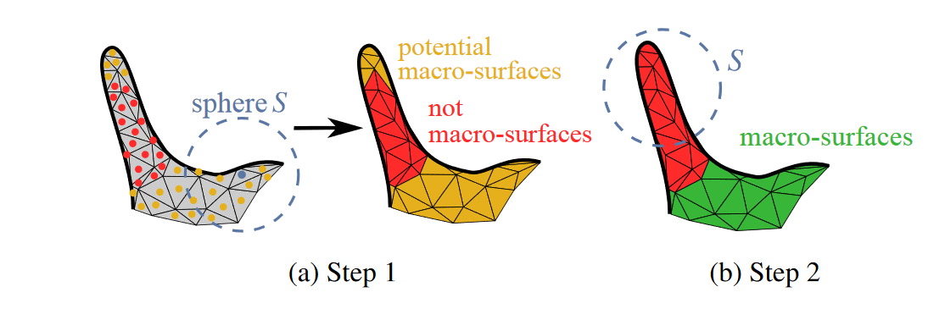
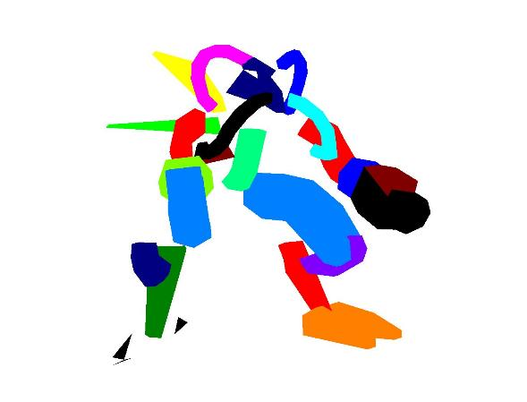
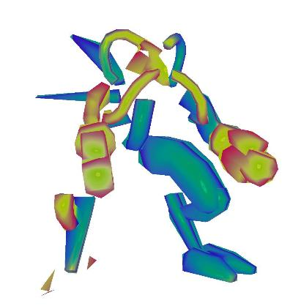
Step 2 : Potentiel To Macro Surface
{List Potentiel Triangle} -> {Component Connexe} -> Intersection Sphere

Slide 12

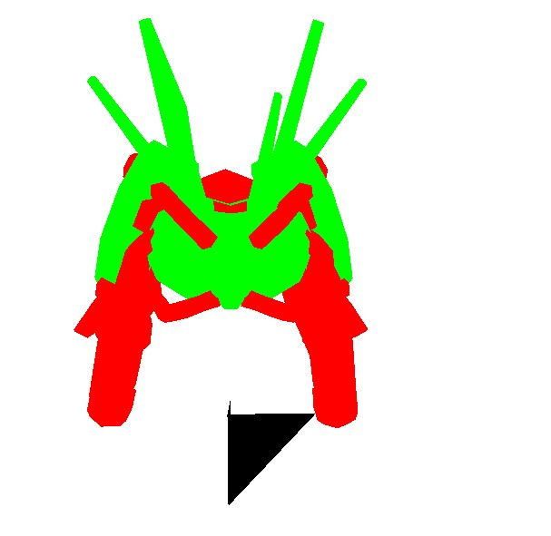

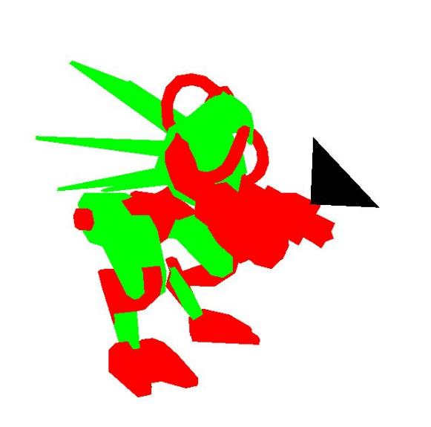
Potentiel To Real Macro
Potentiel Macro | Real Macro

Slide 13
Decimation QEM
Compute the Q matrices for all the initial vertices
Compute the optimal contraction target for each valid pair. The error transpose(v’).(Q1+Q2).v’ of this target vertex becomes the cost of contracting the edges
Priority queue
Remove pair with least cost and update queue

Slide 14
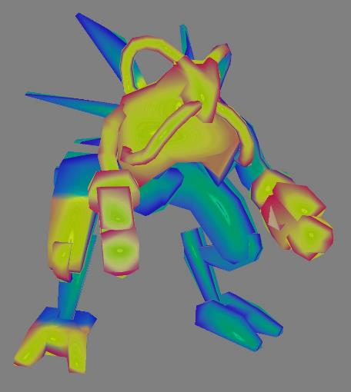
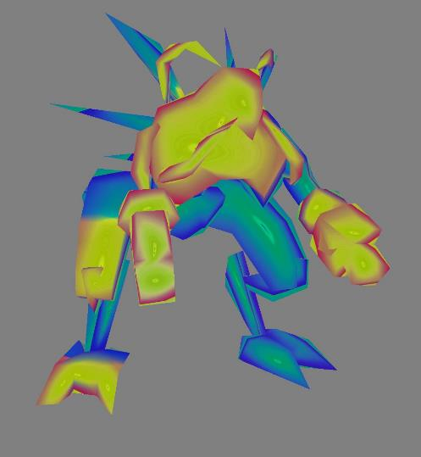
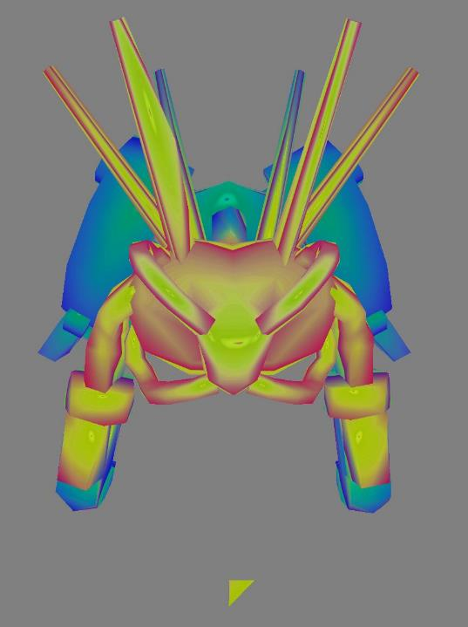

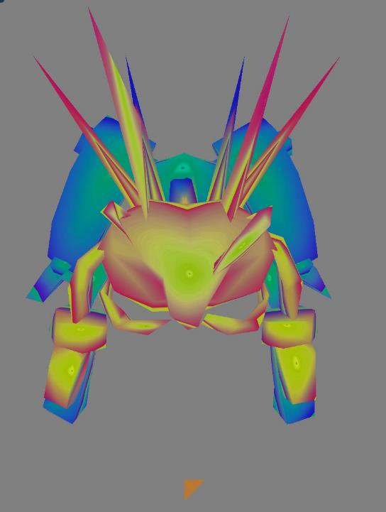
Before | After

Slide 15
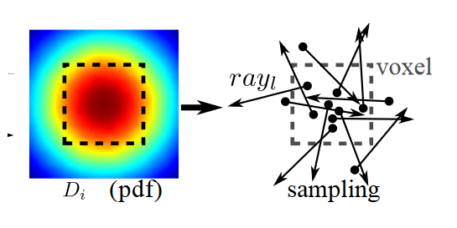
Voxelization
Jakob’s Mistuba render : SSGX distribution / specular and diffuse albedos et density parameters
Need to estimate density parameters :
Ray casting

Slide 16
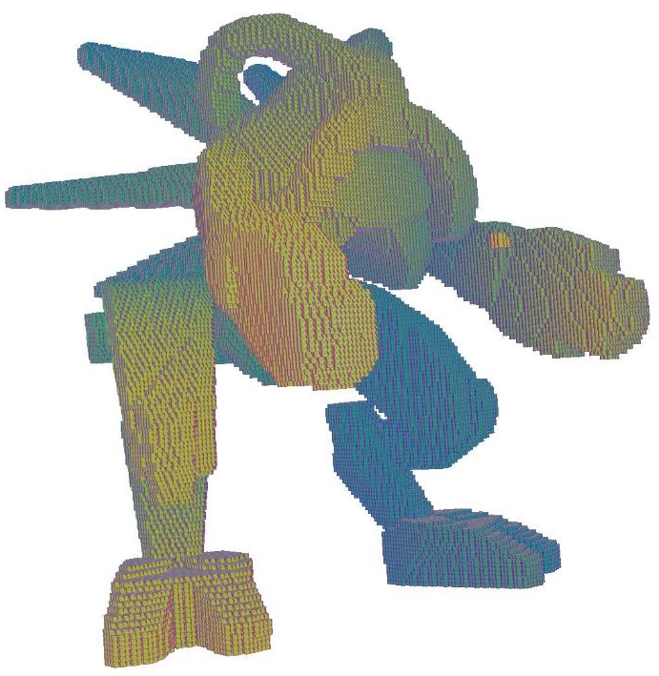
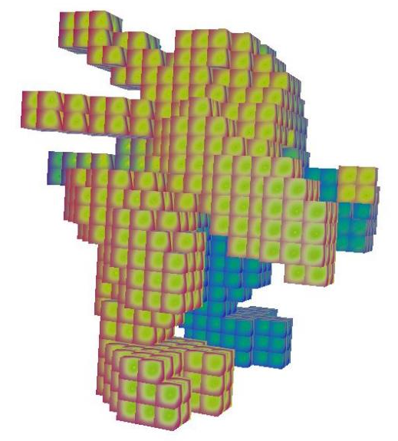
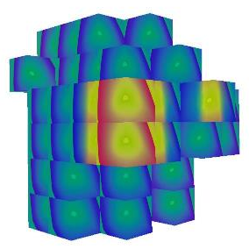
Voxelisation
R = 0,001 | R=0,03 | R=0,3

Slide 17
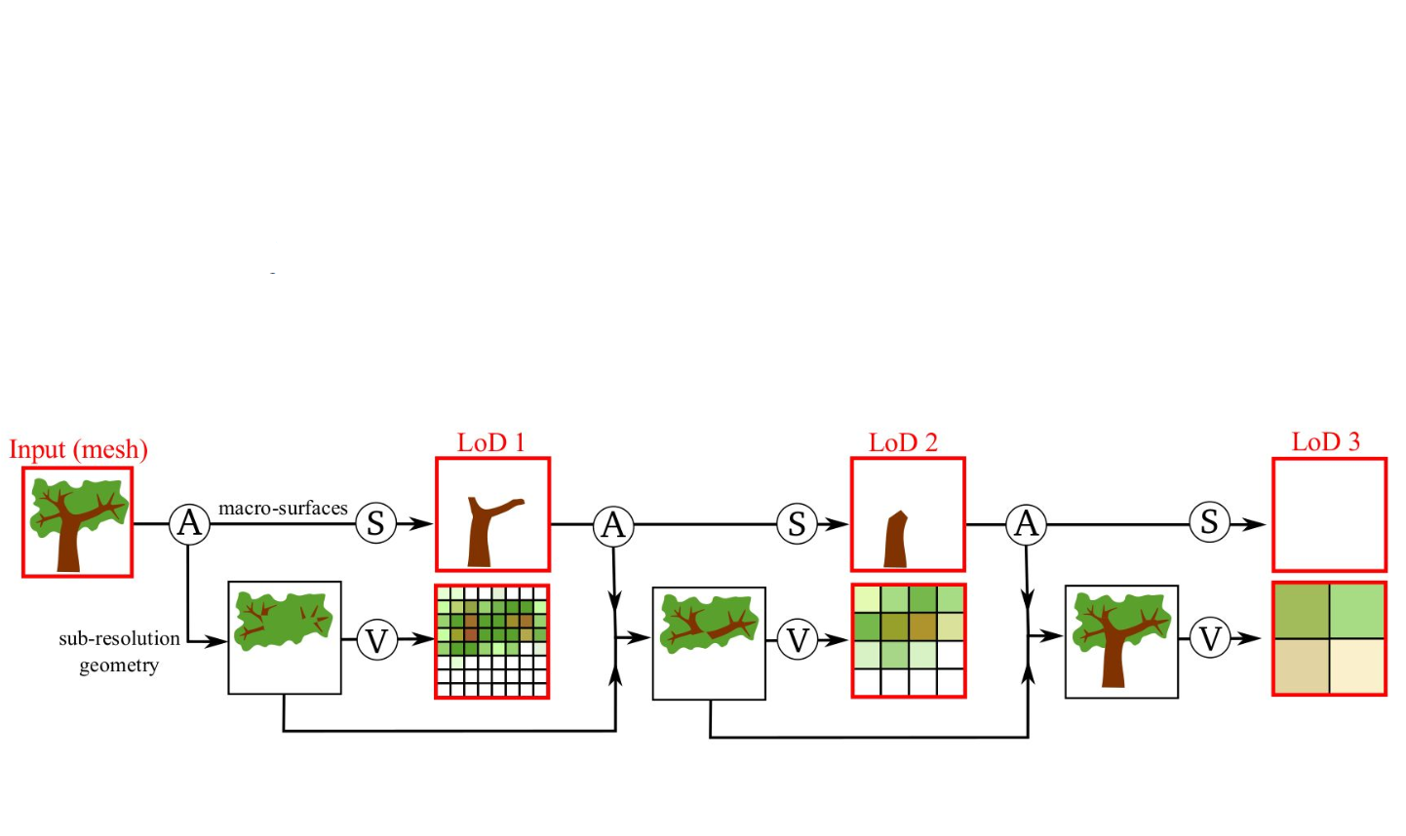
Seamless transition
LoD N
LoD N+1
Interpolation
Coefficient de transparence
Interpolation

Slide 18

List of steps to enable interpolation
Init Potentiel Macro Surfaces
Potentiel To Real Macro Surfaces
Creation of List Macro/Micro
Macro : { Vertex Pos / Tri Index } Micro : { Vertex Pos / Tri Index }
Decim : { Vertex Pos / Tri Index } Vox : { Vertex Pos / Tri Index }
QEM +
storage index
Voxelization
Assemble
Complete_Data_Storage : { Macro / Micro / Vox }
New_Position: { Decim / ------- / ---------- }
Creation List State
{ -1 , >=0 / -1,5 / -2 }
Creation of a Loader to Write/ Load this Data in Files

Slide 19
Demo
Enjoy

Slide 20

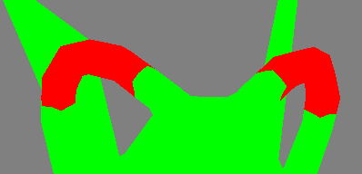
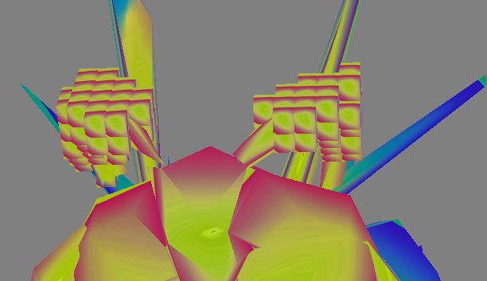
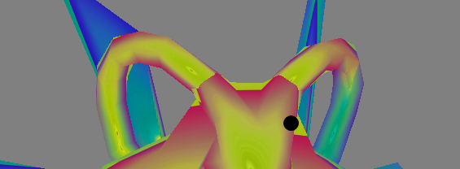
To Do
Ray casting to do beautiful voxelisation
Test other decimations methods to preserve albedo
Enable multiple materials/shader/scale
Make it on GPU
Issues with mesh with multiple independents parts
Limits

Slide 21
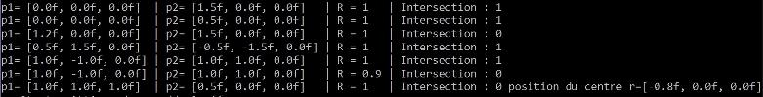

Implementation
Edges structure
Intersection Cercle/Segment/Triangle
Component connexe

Slide 22
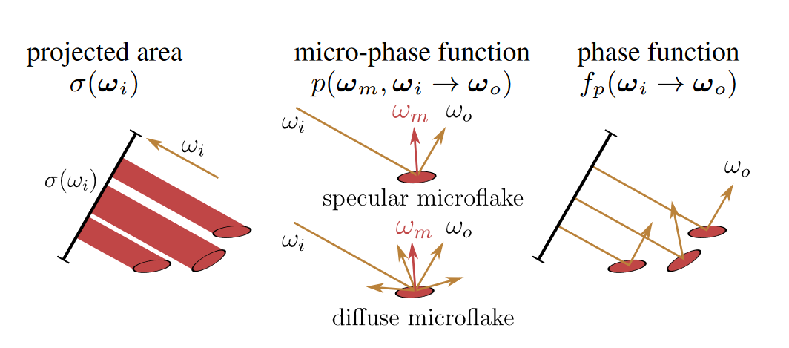
SGGX Distribution
ZHAO -> Building volumetric appearance models of fabric using micro Ctimaging

Slide 23
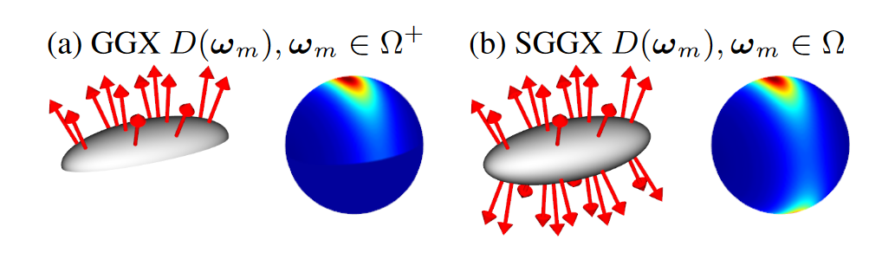
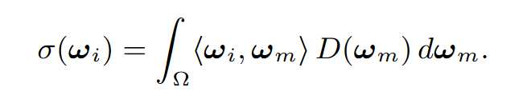
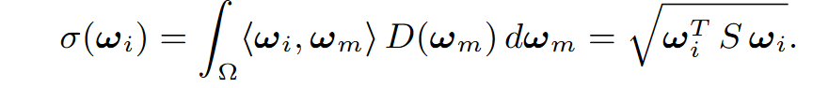
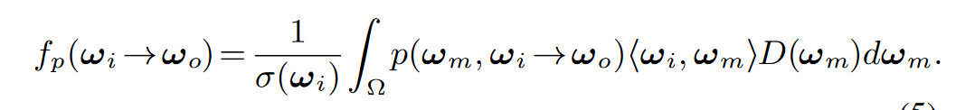
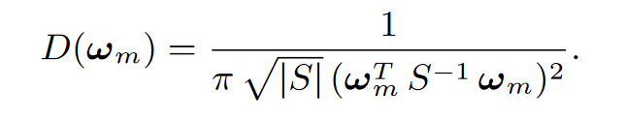
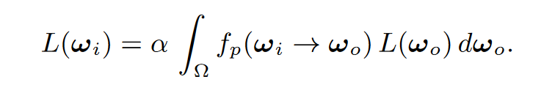

Slide 24
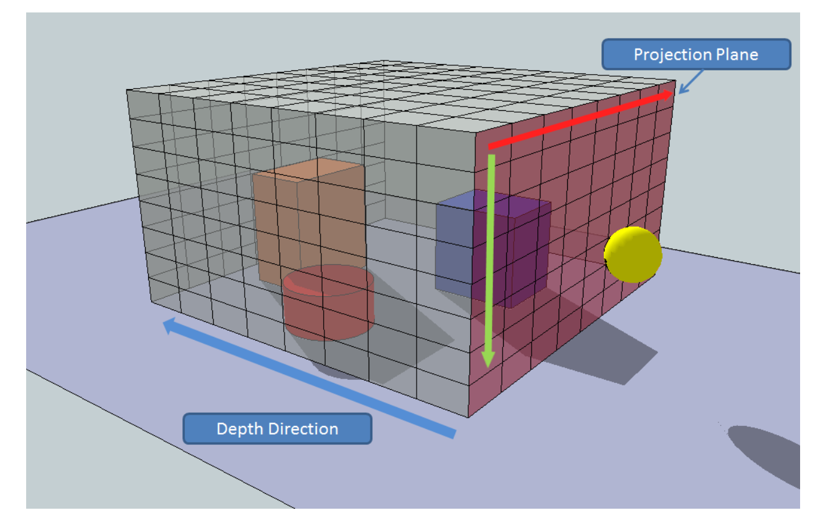
Voxelization

Slide 25
Contributions of this article

Slide 26
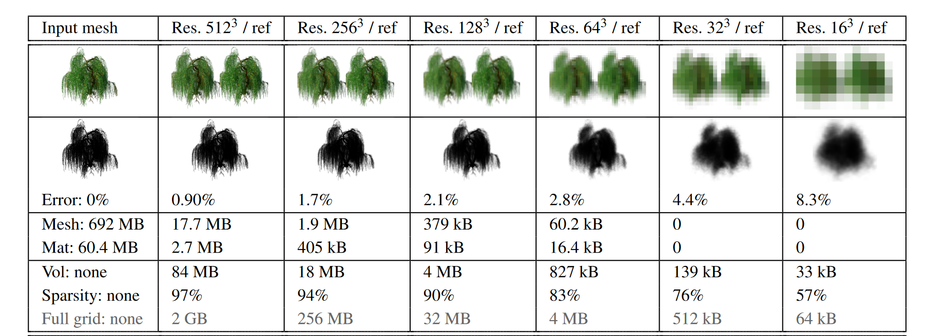
Results

Slide 27
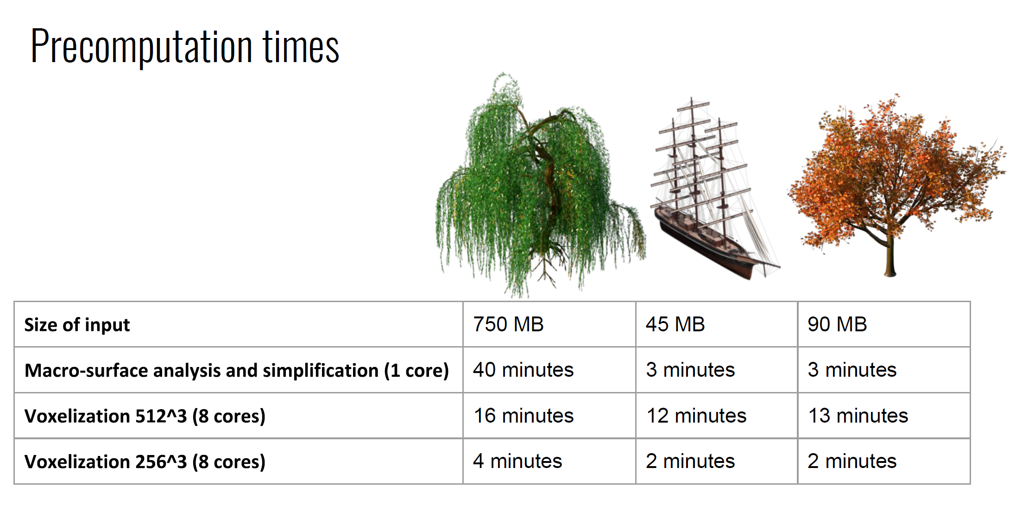
Results

